Slide 1
MEISR
Design Document Presentation
John Andrews, Kevin Ziegler, Stephen Bowles, Sungkyun Kim, Chase Feaster

Slide 2

Problem Definition
Adapt the MEISR into Electronic Form
Provide an Accessible Backend
Reduce Maintenance Time/Effort
http://www.atoztherapies.com/wp-content/uploads/2010/11/learn.jpg

Slide 3
Scope of System
Android App
Web App
Web Portal (Admin)
API/Database

Slide 4
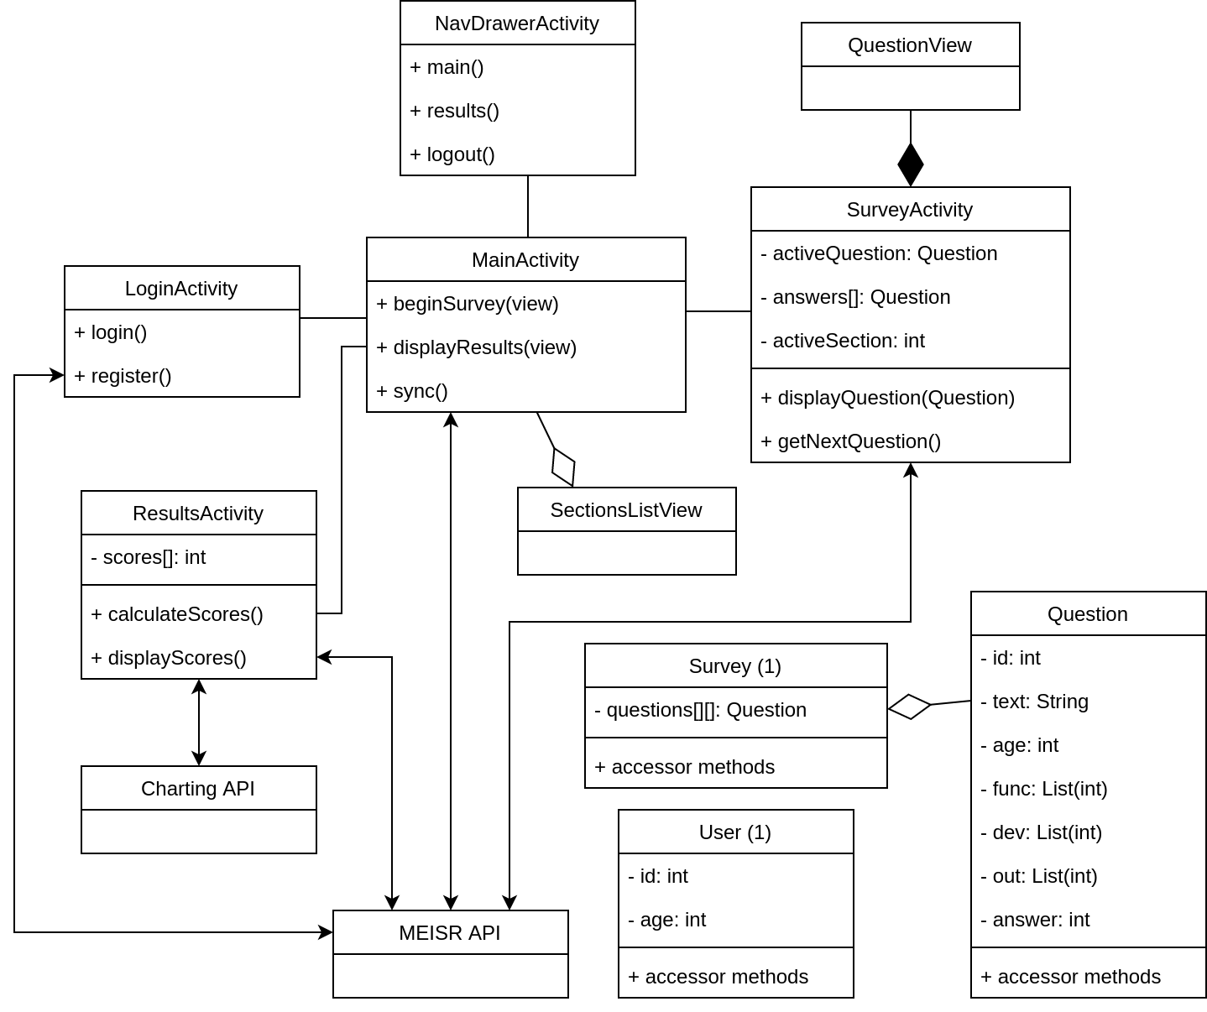
High Level Class Diagram

Slide 5
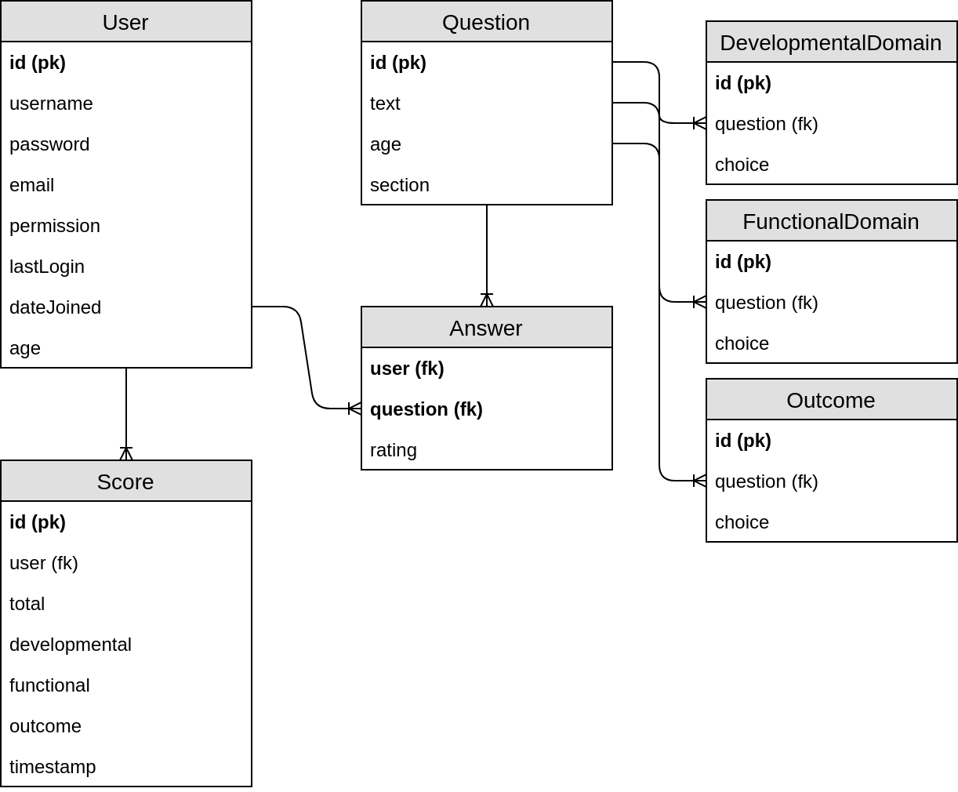
Database Schema

Slide 6
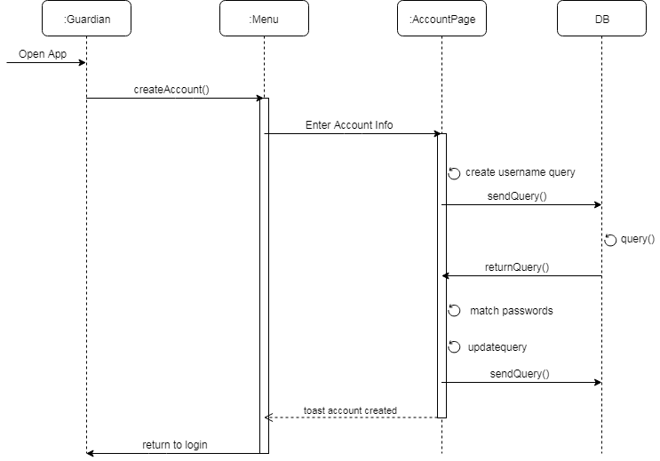
Create Account Sequence Diagram

Slide 7
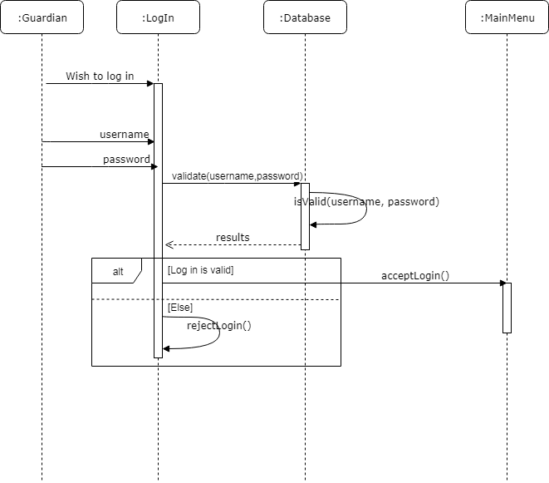
Log In Sequence Diagram

Slide 8
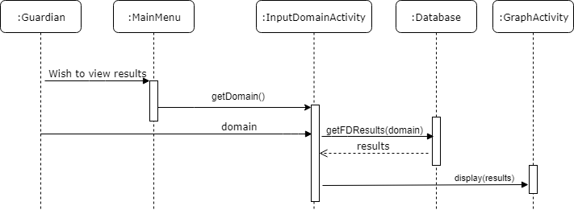
View Results Sequence Diagram

Slide 9
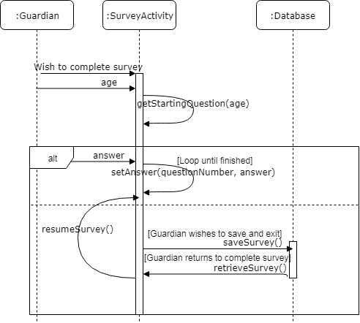
Complete MESIR Sequence Diagram

Slide 10
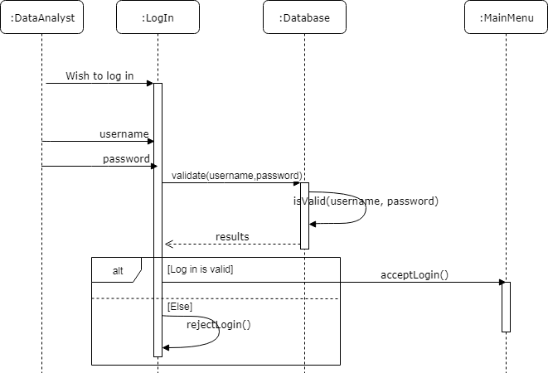
Log In Sequence Diagram

Slide 11
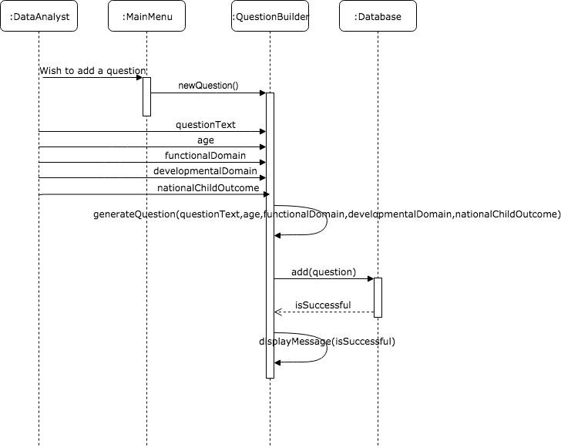
Add Question Sequence Diagram

Slide 12

Update Question Sequence Diagram

Slide 13
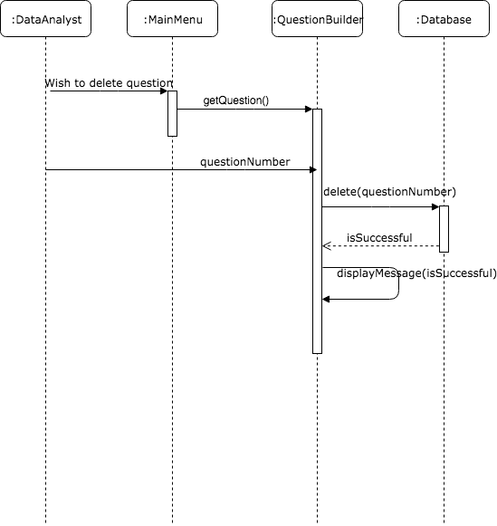
Delete Question Sequence Diagram

Slide 14
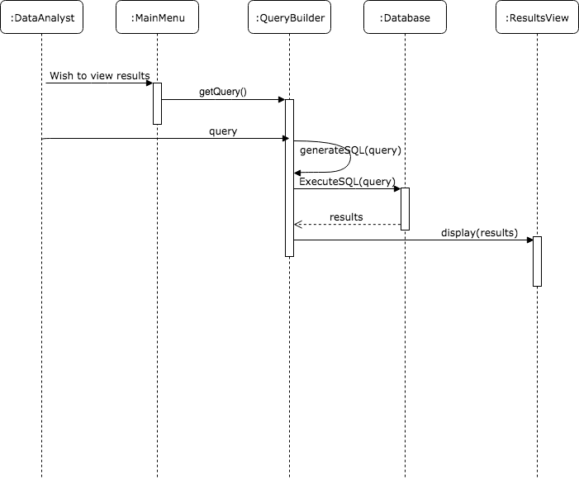
View Results Sequence Diagram

Slide 15

Project Changes
Stretch Goal Added to Main Goals
Prioritize Accessibility
https://generic.wordpress.soton.ac.uk/webscience/wp-content/uploads/sites/117/2014/01/whatis.jpg

Slide 16
Summary
Division of Responsibility
Accuracy of Results
Readability of Results

